Slide 1
TensorFlow Tutorial: Overview

Slide 2
Syllabus
1. Overview
1.1 Machine Learning Fundamentals
1.2 Introduction to TensorFlow
2. TensorFlow Basics
2.1 Installation and Environment Configuration
2.2 Tensor
2.3 Eager and Graph Mode
2.4 Operations
2.5 Advanced Indexing
3. Machine Learning
3.1 Regression: Linear Regression
3.2 Classification: Logistic Regression
3.3 Clustering: K-means Clustering
4. Neural Network
4.1 Introduction
4.2 Neuron and Layer
4.2 Fully Connected Neural Network (FCNN)
4.3 Convolutional Neural Network (CNN)
4.4 Recurrent Neural Network (RNN)
5. Cirq
5.1 Qubit
5.2 Gate and Operation
5.3 Moment
5.4 Circuit Simulation and Sampling
6. TensorFlow Quantum
6.1 Introduction
6.2 Hybrid Quantum Neural Network
6.3 Quantum Convolution Neural Network

Slide 3
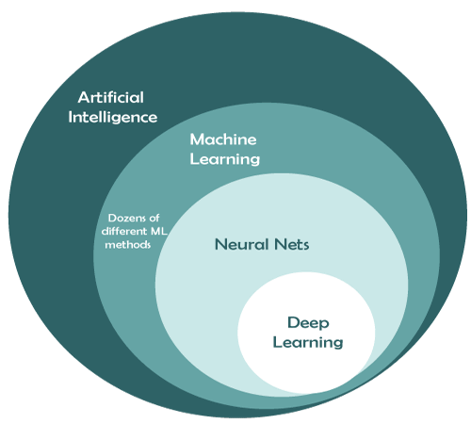
Overview
Before diving into TensorFlow, here are some terms you need to know:
Artificial Intelligence (AI)
Machine Learning (ML)
Neural Network (NN)
Deep Learinng (DL)
As you can see, a field could be another field’s subset and sharing
similar idea, but it is important to understand their nuances to gain a
clear idea of what you are leaning while navigating through this course.
https://www.javatpoint.com/deep-learning-vs-machine-learning-vs-artificial-intelligence

Slide 4
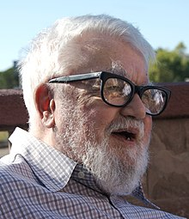
Artificial Intelligence (AI)
John McCarthy, often regarded as the father of AI, was the first put the word “AI” in use and define it with the phrase:
“Intelligence is the computational part of the ability to achieve goals in the world”
Simply speaking, A general idea of AI is a machine that possesses human intelligence
and is capable of performing human-level tasks.
Q: But how can we tell if a computer thinks or acts like a human?
A: Turing test
John McCarthy, 1927 ~ 2011
https://en.wikipedia.org/wiki/John_McCarthy_(computer_scientist)

Slide 5

Turing Test
Proposed by Alan Turing in 1950
The questioner will asks a series of questions to distinguish between human and computer responses without any physical contact.
Computer
Human
respondent
Alan Turing, 1912 ~ 1954
Questioner
https://en.wikipedia.org/wiki/Alan_Turing

Slide 6
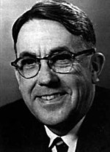
Machine Learning (ML)
The term “Machine Learning” was first introduced by Arthur Samuel in 1959:
“ Machine learning enables a machine to automatically learn from data, improve
performance from experiences, and predict things without being explicitly programmed. “
In other words, Machine Learning is a set of approaches to achieving the goal of AI.
Arthur Samuel, 1901 ~ 1990
https://en.wikipedia.org/wiki/Alan_Turing

Slide 7
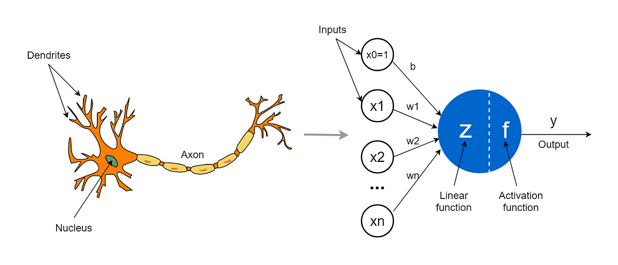
Deep Learning and Neural Network
1. Deep Learning (DL)
Brabnch of Machine Learning
Relies on Neural Network as its backbone
2. Neural Network (NN)
The core algorithm of Deep Learning
Consists of artificial neurons and multiple layers.
We will delve deeper into this topic in chaper 4.
https://towardsdatascience.com/the-concept-of-artificial-neurons-perceptrons-in-neural-networks-fab22249cbfc

Slide 8
Machine Learning vs Deep Learning
Machine Learning
Based on traditional ML algorithms such as linear regression and decision trees.
The training data can be small, but must be structured
Short training time
Required a lot of tweaking and tunning to identify the features
Deep Learning
Based on single or multi-layer neural networks
Large amount of unstructured training data
Training time varies depending on model’s complexity.
Features are extracted automatically during the training phase

Slide 9
How Machine Learning Works
1. Decision process
Generate a result of prediction or classification.
2. Error function (loss, cost function)
Evaluate the model in terms of predicting the expected outcome by
computing the error between the hypothesis and target value.
3. Model optimization process
Update the weights of the model to minimize the error calculated by
error function. This process will repeat over and over again until a
threshold or a required accuracy is met.
Data
Model
Prediction
Optimization
(Training)
Error Function
https://www.ibm.com/topics/machine-learning

Slide 10
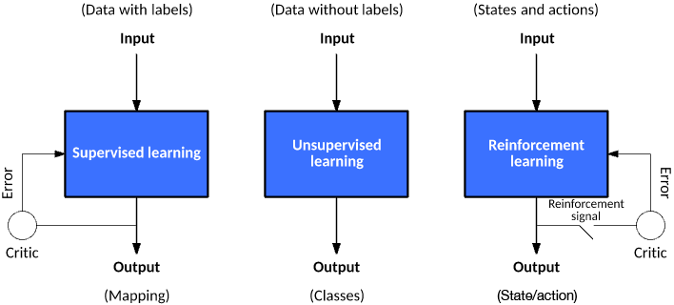
Types of ML
1. Supervised learning:
The input data are labeled, so we simply compare the
prediction with the labels to check if the output is correct.
2. Unsupervised Learning:
The input data are not labeled in this learning type. The
goal of unsupervised learning is to categorize the data
into different groups or classes with similar features.
3. Reinforcement Learning:
In the training process, it gets a reward for each right
action and gets a penalty for each wrong action, which is
a feedback-based learning model.
https://developer.ibm.com/articles/cc-models-machine-learning/

Slide 11
Supervised Learning
Utilizing Supervised Learning, the model can construct a connection between data features and labels
The illustration below demonstrates how it works:
Prediction
Circle
Square
Triangle
Circle
Rectangle
Learning
Parallelogram
Rectangle
Triangle

Slide 12
Unsupervised Learning
Unlike Supervised Learning, Unsupervised Learning aims to analyze unlabeled data and classify them into clusters.
Clustering
Learning

Slide 13
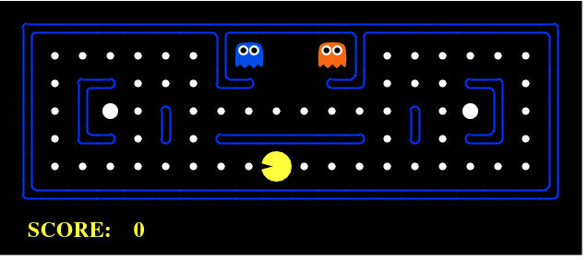
Reinforcement Learning (RL)
For Reinforcement Learning, there is an agent capable of observing the surrounding environment
and perform actions to get a better reward. we want it to learn a strategy or policy letting it make the
optimal decisions to achieve the highest possible overall reward.
The Pac-Man get the score (reward) by taking different types of movements.
http://ai.berkeley.edu/project_overview.html

Slide 14
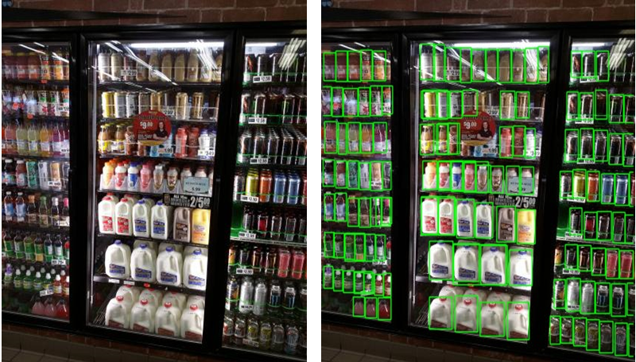
ML Application: Object Detection
By combining object recognition and image classification, it has found extensive applications in the field of computer vision.
Keep track of the items on the shelves in a checkout free store
https://blog.roboflow.com/retail-store-item-detection-using-yolov5/

Slide 15

ML Application: Recommendation System
Many social media platforms and online stores employ deep learning-based recommendation algorithm for their services.
Amazon shows their merchandises based on user’s interests
https://www.amazon.com/

Slide 16

ML Application: Nature Language Processing (NLP)
ChatGPT is a great example to showcase the power of a large language model in the NLP field.
A human-like chatbot is now something we can’t do without
https://www.brookings.edu/articles/chatgpt-educational-friend-or-foe/

Slide 17






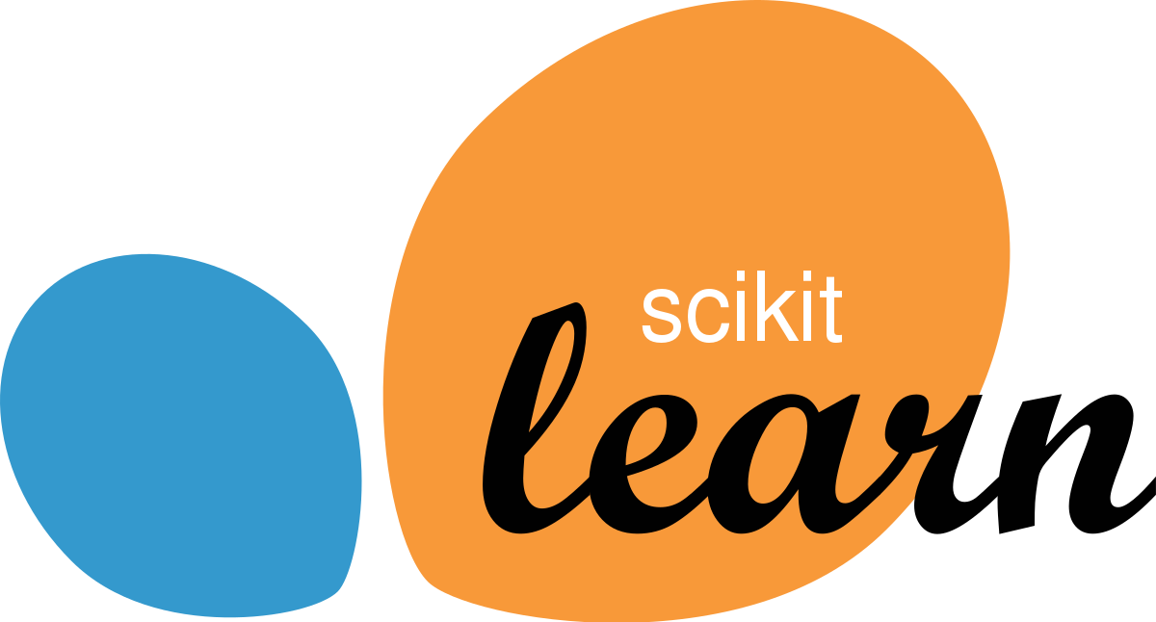

Python Libraries for ML
TensorFlow 2
Sklearn
Numpy
Matplotlib
Keras
The basic knowledge about Python and mathematics are
required for a better understanding of TensorFlow, so
please take some time to look at these topics.
Libraries covered in this tutorial
Some other popular libraries for ML

Slide 18
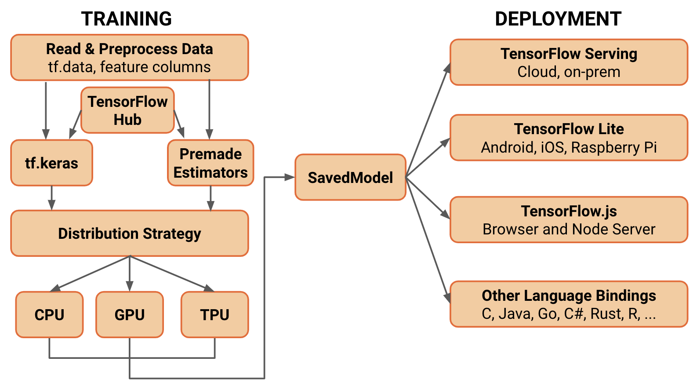
What is TensorFlow
An open-source ML framework
Developed by Google Brain team, released in 2015
High-level APIs
APIs like tf.keras and tf.estimator simplify the model construction,
makes it beginner-friendly and easy-to-use.
Low-level APIs
Provides a great amount of mathematical operations on tensors, e.g.,
matrix(tensor) multiplications, Cartesian product, etc.
Portability
TensorFlow Lite can convert a model into a smaller and more efficient
one, which is beneficial to mobile and edge devices.
https://blog.tensorflow.org/2019/01/whats-coming-in-tensorflow-2-0.html

Slide 19
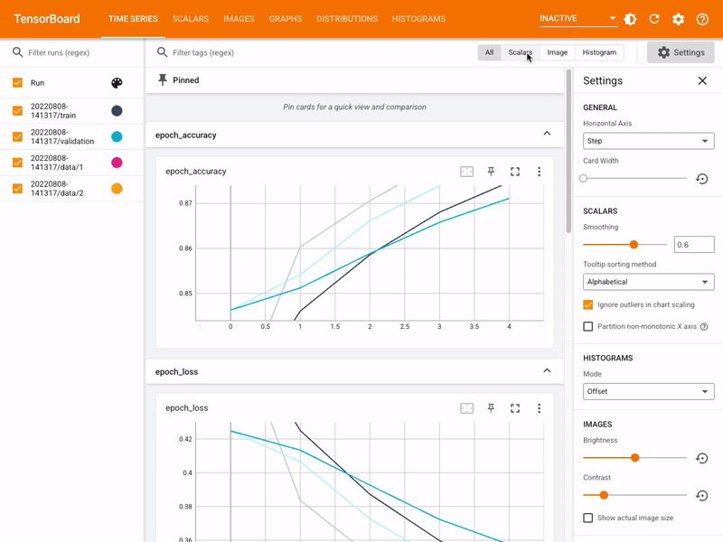
What is TensorFlow
TensorFlow is a great tool to build models for various type of ML applications:
1. Computer Vision
2. Data Clustering
3. Regression
Moreover, with the help of TensorBoard, you can visualize the model to better
understand the training process and improve model performance by updating
the hyperparameters.
4. Reinforcement Learning
5. Nature Language Processing
6. Deep Learning
https://www.tensorflow.org/tensorboard?hl=zh-tw

Slide 20




TensorFlow: Community
TensorFlow has one of the largest and most active communities among ML
libraries that you can benefit from, there are many advanced programmers
and developers that can help you out, so make sure you reach out to others
if you encounter problems learning it.
You can also use ChatGPT to solve your problem!
Official Documentation

